Slide 1
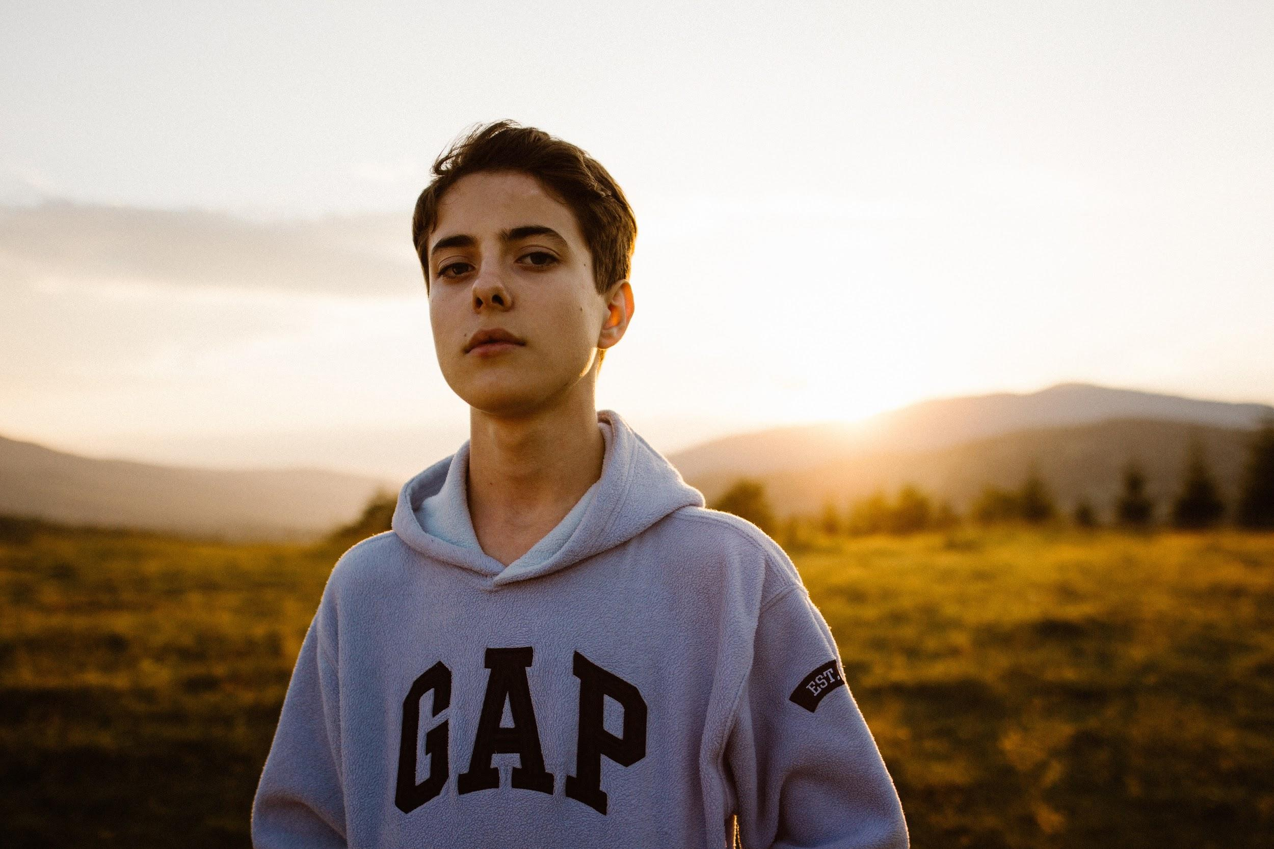
Notes:
Think back to the time when you were in school. You are entering year 11 and soon your GCSE exams are coming up. And while most of us in this room probably never had to worry about whether there will be food on the table or whether they can go home at all at the end of a school day, these are issues Jordan faces on a regular basis. Jordan is a 16 year old student from Lewisham who is raised by a single mother with two jobs. Unfortunately, Jordan has never had someone that shows him that there is more for his future- that there is HOPE. And Jordan is just one of many young students in the UK.

Slide 2
857,000 youths
11.9%
12% fall
Between 16-24 not in education, employment or training
Of all young people
In apprenticeship participation
Notes:
According to the office of national statistics, one in ten young people between 16 and 24 are not in education, employment or training. That makes up 11.9% of all young people. Furthermore, there is a 12% fall in apprenticeship participation. In response to this, we introduce
BOSS BOOST: BOOSTING THE BOSS IN YOU

Slide 3

Notes:
Boss Boost is an online platform that matches youths, university students and industry professionals with similar interests and backgrounds, to create a support system for lower-income youths at risk of dropping out of high school. Through this system, we aim to provide mentoring and tutoring sessions, and career advice for youths (and university students) to succeed in and further their studies.

Slide 4

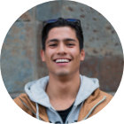
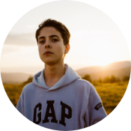
Solution
Carrie
University Student
Sebastian
Industry Professional
Jordan
School Student
Notes:
Starting in London, our platform Boss Boost creates a 3-way relationship between … This will enable well qualified students and industry professionals to reach out their hand and lift vulnerable school students such as Jordan to their full potential, preventing them from falling by the wayside or into the hands of exploitative gangs.
Our university students will provide academic support through video tutorials on chosen subjects.
Our industry professionals can allow the school students to get to know more about their respective industries and give them long-term motivation to study hard in school so that they can follow in their footsteps. Near the end of the programme, our mentees will have the chance to receive guidance through application processes for work placements if they have found an area they are interested in.

Slide 5
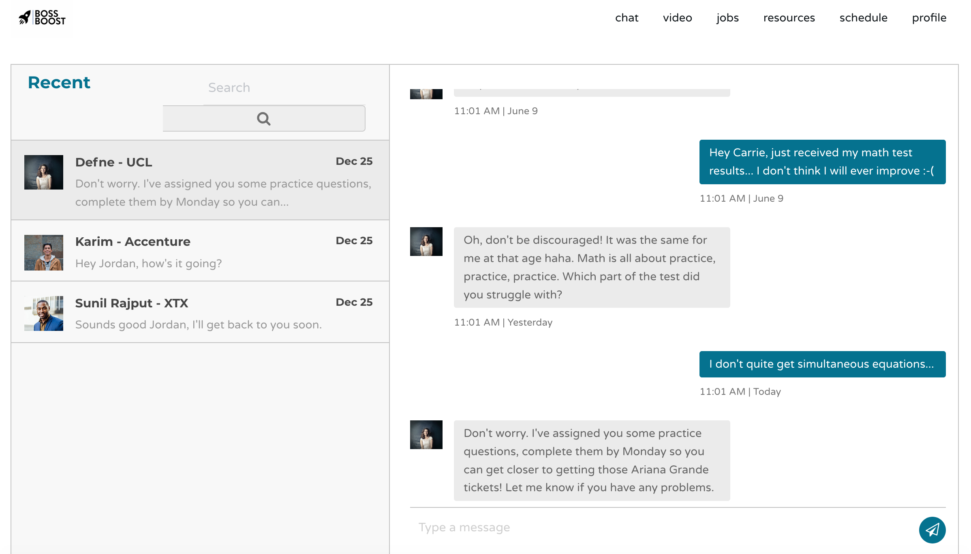
Key Features
Chat and video platform
Notes:
Chat and video platform - more accessible - no need to travel
Some people may be daunted by having to meet face to face
Chat platform is the main channel for communication - organise video calls, give assignments
Video for tutor sessions

Slide 6
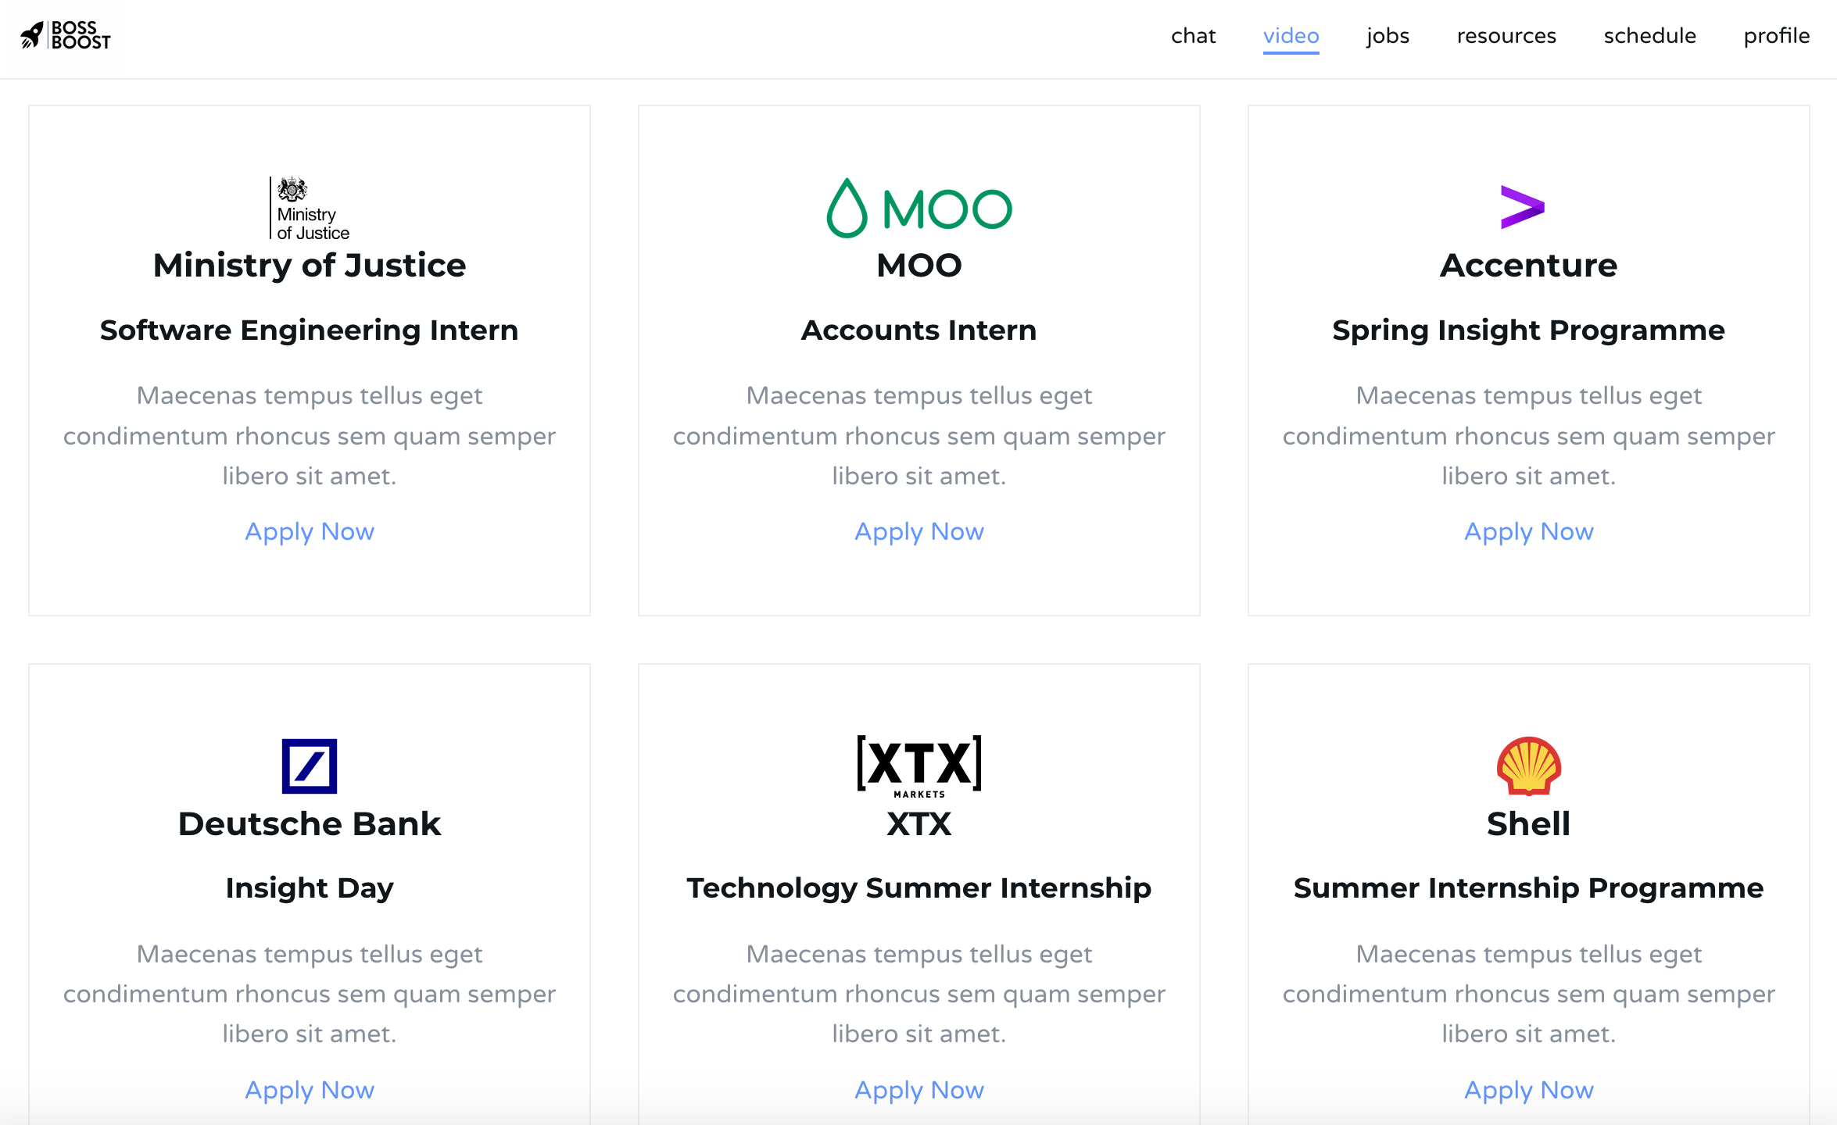
Key Features
Jobs Board
Notes:
For companies to publicise their placement/internship opportunities

Slide 7
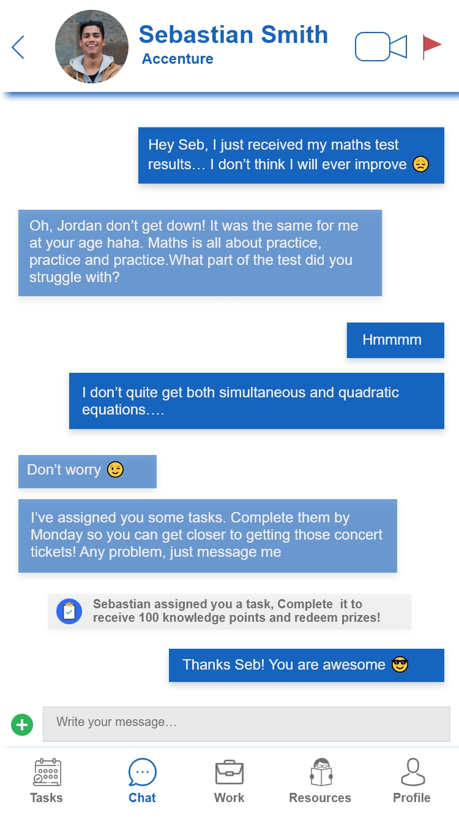
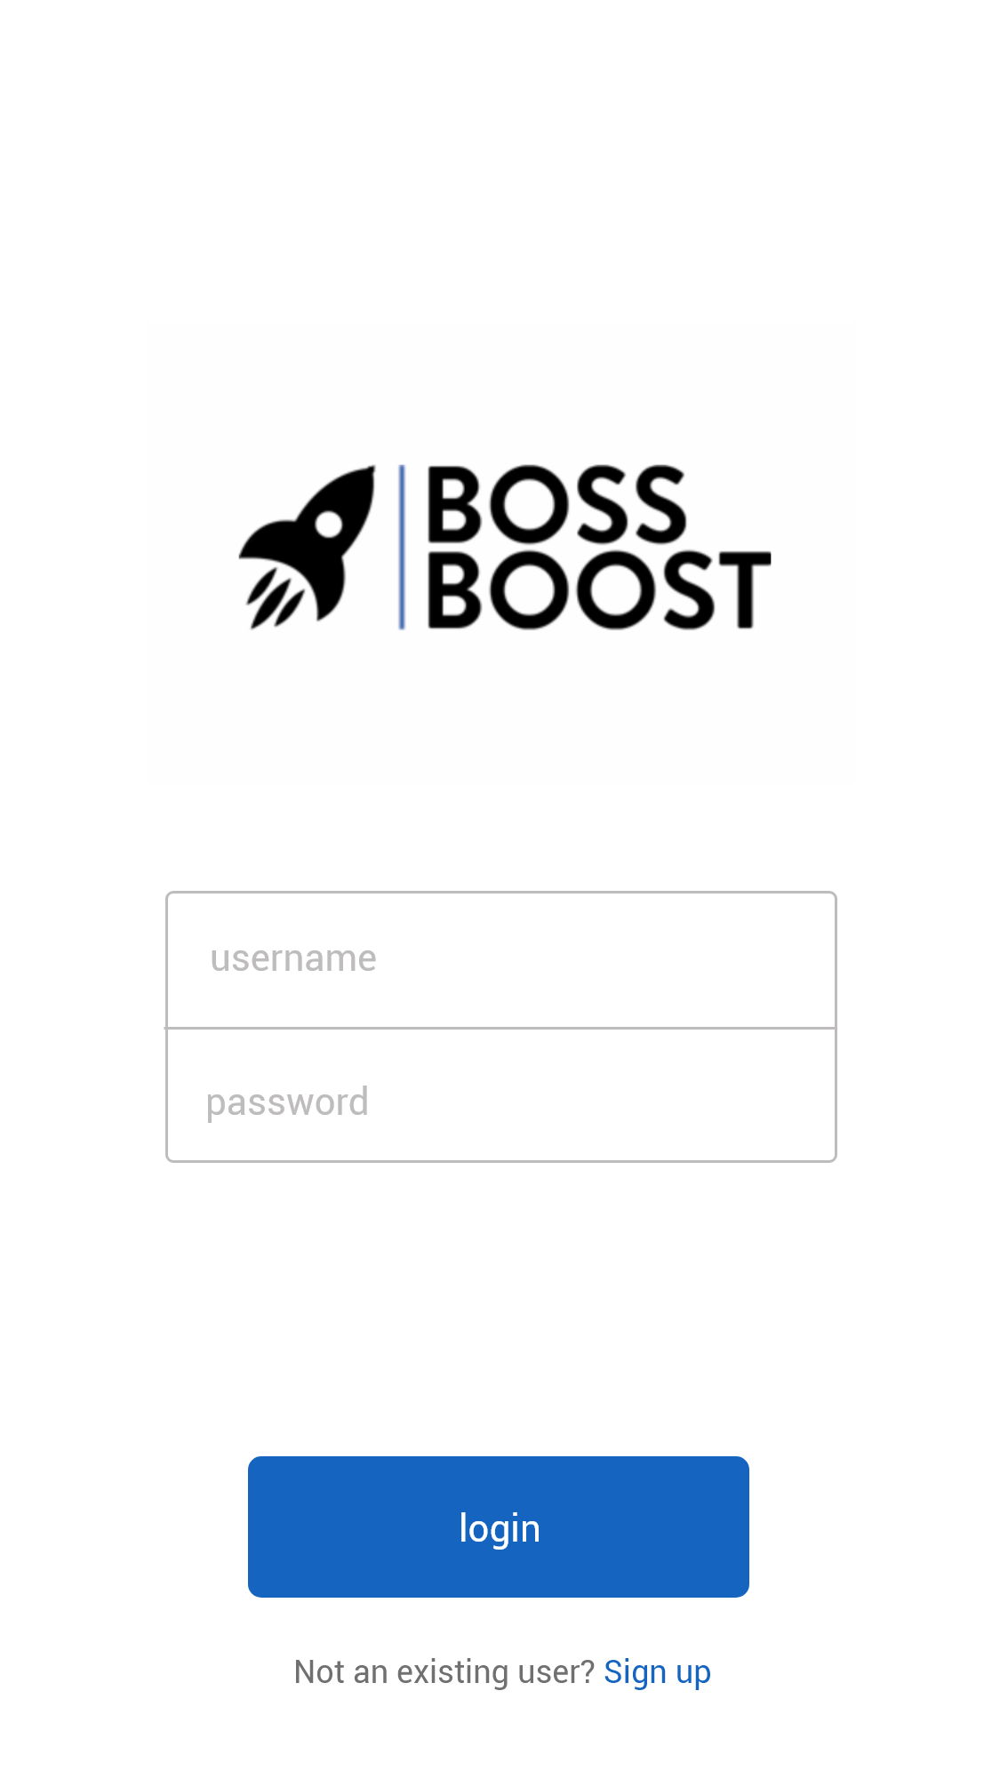
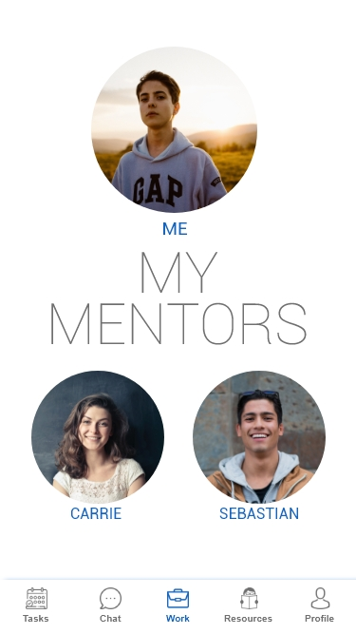
View our website
Notes:
There will also be a mobile platform, as Based on our survey, any youths in our target group prefer using mobile devices to communicate with one another

Slide 8
Our Marketing Efforts
Corporate Sponsors
Schools
Most vulnerable Students
University Students
Notes:
Example for Schools: Example: This can be done through contacting schools in disadvantaged areas by phone, email or in person.
Example: This can be done through contacting schools in disadvantaged areas by phone, email or in person.
Example of Volunteering projects for university students “Adopt a student” concept
Through University societies & incentives in their own application process
Example: Deutsche Bank sponsors the FinTech society.
“Adopt a student” concijdfifiiddidkd

Slide 9
Revenue Streams
Corporate Sponsors
Example: Grants such as Deutsche Bank “Born To Be” initiative.
Gamification System
Advertising from the Rewards system (eg: Unidays, StudentBeans)

Slide 10
Next steps
Expansion outside of London
Engaging with influencers and celebrities with similar backgrounds
More diverse advertising (for rewards/gamification system)
App integration (android, iOS)
Notes:
We will start by launching our product in towns around London.

Slide 11
Team
Natasha Manacika
Alex Haseldine
Faye Sirohi
Ashly Lau
Hamza Jahangir

